Slide 1
Relationships between tables
Tables in a database are linked, or related
There are three possible ways in which two tables may be related:
One-to-one e.g. Husband and Wife
One-to-many e.g. Mother and Child, School and Pupil
Many-to-many e.g. Actor and Film, Recipe and Ingredient

Slide 2
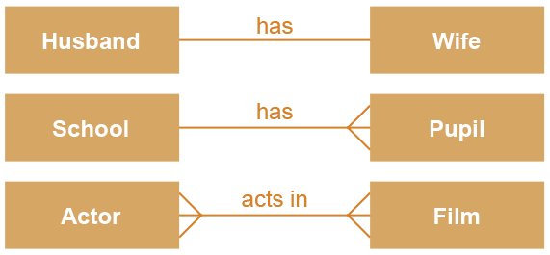
Entity relationship diagrams
An entity relationship (E-R) diagram is a graphical way of representing the relationships between tables
We can say, for example, that one school has many pupils, or many pupils attend one school
One-to-One
One-to-Many
Many-to-Many

Slide 3
One to many examples
Coach and Players
Person and Shoes
Pastor and Worshipers
Employer and Employees
Teacher and Classes
Hairdresser and Clients
Pope and Cardinals
League and Teams
Beach and GrainsOfSand

Slide 4
Many to many examples
Nurses and Patient
Browsers and Servers
Teachers and Students
Students and Courses
Shops and Shoppers
Footballs and Players
Apps and Phones
Artists and Fans

Slide 5
One to one examples
Country and flag
Husband and wife
Country and Capital
Person and Birth
HTML head and HTML body
Person and NIN
Person and driver's licence
Face and Name

Slide 6
Draw the ERD a database with the following tables:
1) Music:
artists
albums
songs
2) World BD:
continents
countries
cities
3) Company:
departments
employees
projects
assignments
4) Auction - eBay:
sellers
products
buyers
auctions
5) Literature
publishers
books
authors
reviews
reviewers

Slide 7
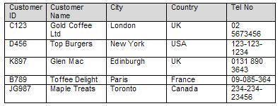
primary keys
First: we give EVERY record on our table an identity: a column that identifies that row. We called that identity the row’s primary key
Example: Table is Customer and id is Customer ID

Slide 8
primary keys
Which of the following row work as a primary key for the passports?
Name
Address
DOB
Passport number
Height

Slide 9
primary keys
How do we choose which column is the primary key – the identity - in a table?
It should be unique for each row.

Slide 10
primary key
Good and bad selections for primary keys.
On table “student”:
“Date of birth” is …
“Student number” is good …
“Name” is not good …

Slide 11
primary key
Good and bad selections for primary keys.
On table “student”:
“Date of birth” is NOT GOOD… why?
“Student number” is GOOD… why?
“Name” is NOT GOOD… why?

Slide 12
primary key
Primary key is a COLUMN in our table
This means that EVERY row has a primary key assigned to it:

Slide 13
primary keys as integers
There is one way to eliminate having to think about whether a column is unique or not:
id is going to be our primary key. It will be an integer starting from 1,2,3 ….

Slide 14
Summary
What is a Primary key?
What values can a Primary key have?

Slide 15
How is a relationship actually implemented?
Let’s take the example of Category and Product
How can we specify that Product X is of Category Y?

Slide 16
foreign keys
Every table whose records references records in another table has an extra row.
For example each of our Products needs to say which Category they are of.
We need to use the PRIMARY KEY of Category inside the Products table. When it is inside the Product table we will call it a FOREIGN KEY.

Slide 17
foreign keys
An extra row on table Product called “CategoryID” –is for FOREIGN KEY.
The primary key of the row of the category this product is in.

Slide 18
One to One
ONE to ONE relationships works exactly the same way a ONE to MANY works:
One of the tables has the other’s PRIMARY KEY as a FOERIGN KEY

Slide 19
keys, tables, and many to many relationships
What do we do about Products and Orders?
Draw simple ERD diagram
Many Products can be in one Order
One Product can be in many Orders
It’s a one to many either way or
MANY TO MANY

Slide 20
Intermediate table
Table OrderDetails
OrderID
ProductID

Slide 21
Films
In a films database, you have tables “actor”, and “film” (draw).
What relationship is there between “actor”, and “film”?
one to one
one to many
many to many

Slide 22
Films
Draw the simple ERD and then the full ERD
Fill in the tables with Primary and Foreign keys wherever necessary.

Slide 23
Films
How is this relationship implemented?
Where does the _______ table go?
For 10 films and 10 actors how many lines does the _______ table have?

Slide 24

E-R diagram
There is a one-to many relationship between Customer and Subscription
One customer may have several subscriptions, but a particular subscription belongs to only one customer
There is a one-to-many relationship between Product and Subscription
One product may appear on several subscriptions, but a subscription is for only one product

Slide 25
Creating a relationship
To create a relationship between Customer and Subscription, we need to include custID in the entity description of Subscription
Subscription (subID, startDate, endDate, custID )
ProductId also needs to be included in the entity description of Subscription
Subscription (subID, startDate, endDate, custID, productID)
custID and productID are foreign keys in Subscription, shown in italics
A foreign key always goes on the “many” side of a relationship

Slide 26
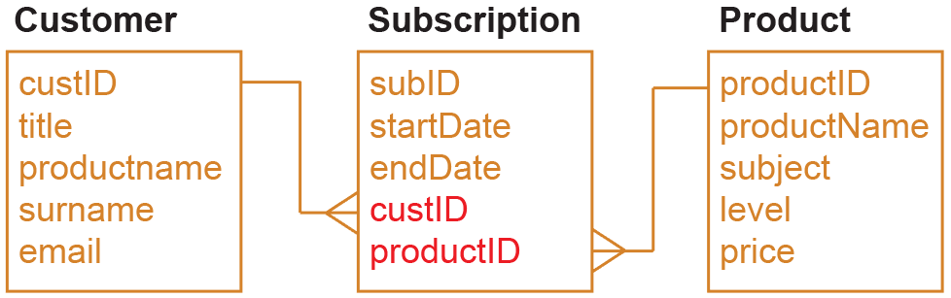
Foreign key: definition
A foreign key is an attribute that creates a join between two tables (relations)
It is the primary key in the first relation
Draw an entity relationship diagram to show the relationships between the three entities

Slide 27
RevisionSubs tables
tblCustomer
custID | title | firstname | surname | email
C111 | Mr | Fred | Carr | fcarr53@gmail.com
C245 | Miss | Mabel | Jenkins | mabel777@bt.com
C364 | Miss | Jasmine | Kumar | jkumar@icloud.com
tblSubscription
subID | startdate | endDate | custID | productID
S1211 | 25/02/2016 | 24/02/2017 | C111 | P36
S1212 | 01/02/2016 | 31/01/2017 | C111 | P47
S1213 | 04/02/2016 | 03/02/2017 | C245 | P36
tblProduct
productID | productName | subject | level | price
P24 | Equations | Maths | 2 | £12.00
P36 | Programming | Comp Science | 4 | £25.00
P47 | Database | Comp Science | 4 | £25.00

Slide 28
Many-to-many relationships
You would need several fields in tblCustomer to hold the ProductID of each product a customer has subscribed to
But how many fields would you allow?
How would you find all customers who had subscribed to a particular product?
custID | title | firstname | surname | email | ProdID1 | ProdID2
C111 | Mr | Fred | Carr | fcarr53@gmail.com | P36 | P47
C245 | Miss | Mabel | Jenkins | mabel777@bt.com | P36
C364 | Miss | Jasmine | Kumar | jkumar@icloud.com | P25 | P36

Slide 29
Many-to-many relationships
This configuration does not work
It is impractical to allow several fields ProdID1, ProdID2, etc.
You cannot easily extract information from this table
An alternative way of organising the data is required
custID | title | firstname | surname | email | ProdID1 | ProdID2
C111 | Mr | Fred | Carr | fcarr53@gmail.com | P36 | P47
C245 | Miss | Mabel | Jenkins | mabel777@bt.com | P36
C364 | Miss | Jasmine | Kumar | jkumar@icloud.com | P25 | P36

Slide 30

Many-to-many relationships
When there is a many-to-many relationship between tables, they cannot be directly linked
For example, you cannot link the entities Customer and Product directly
Why not?

Slide 31


Linking tables
Suppose you have a table holding details of gym members and the classes they take – yoga, indoor cycling, pilates, interval training, etc.
You need a link table “in the middle” just as the entity Subscription was between Customer and Product

